Slide 1
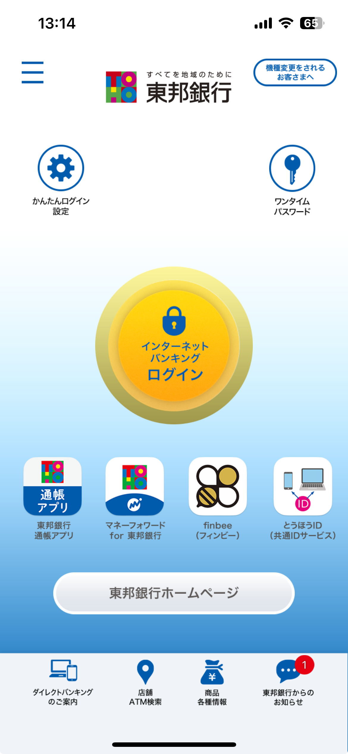
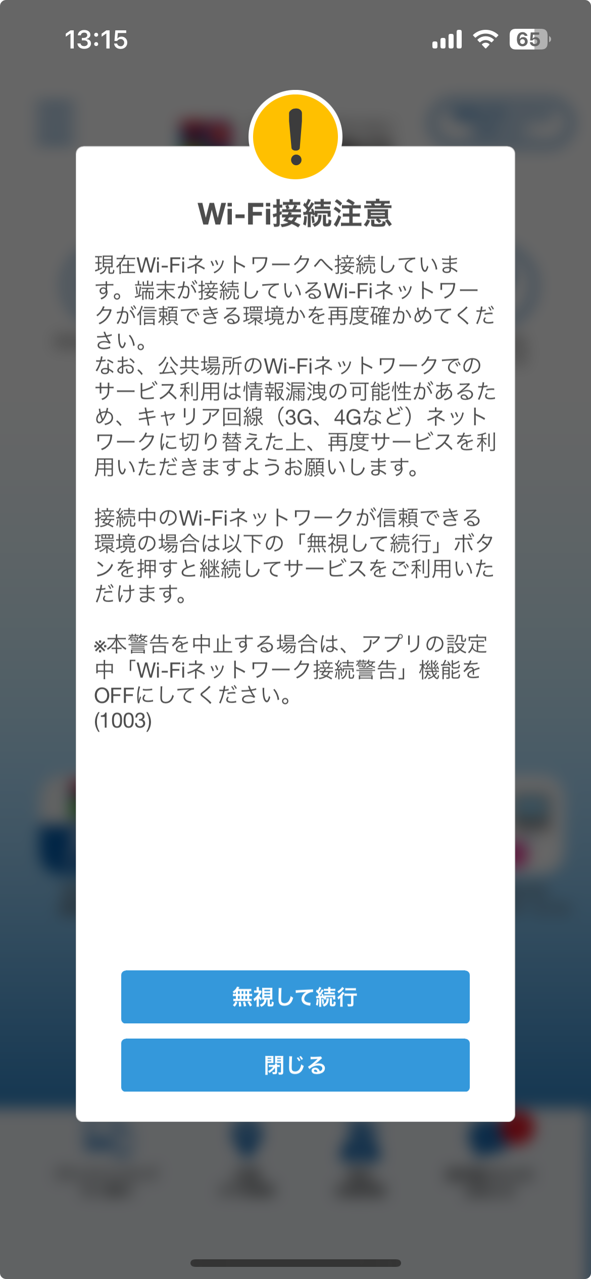
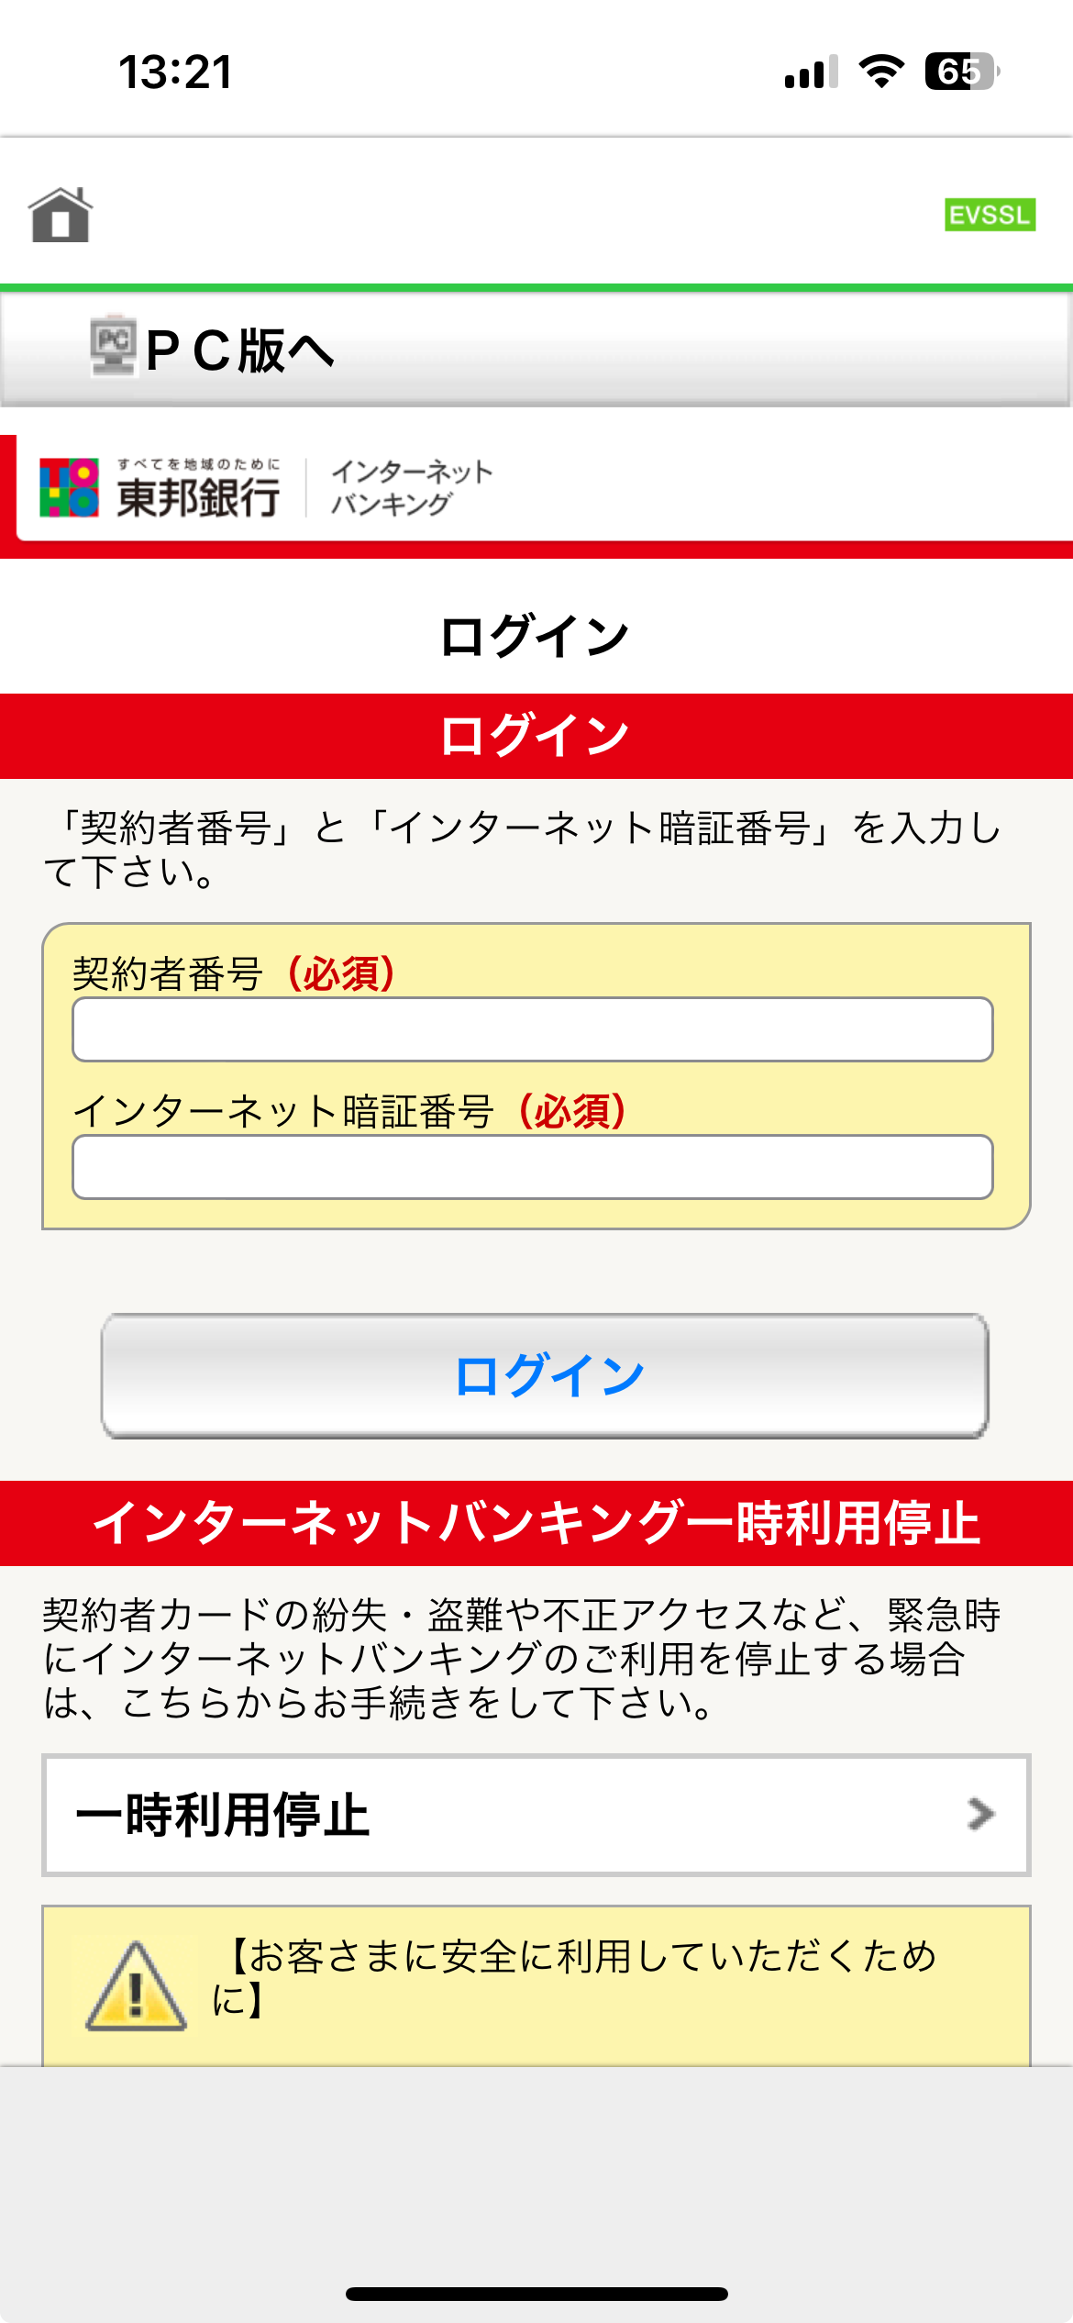
Press
Type Login ID
Type Password
activate FaceID authentication for future use
Press

Slide 2
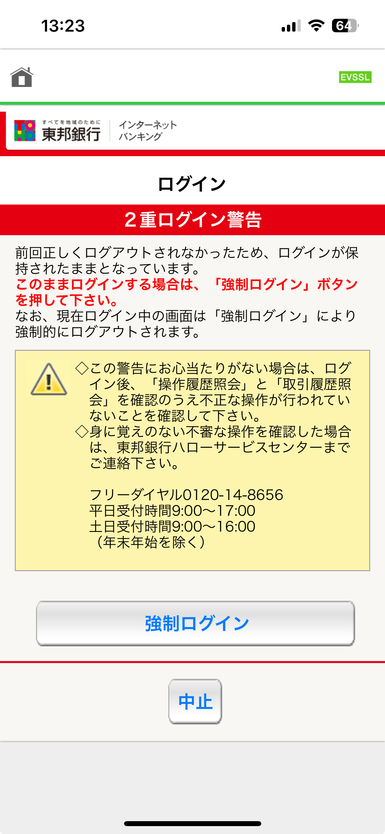
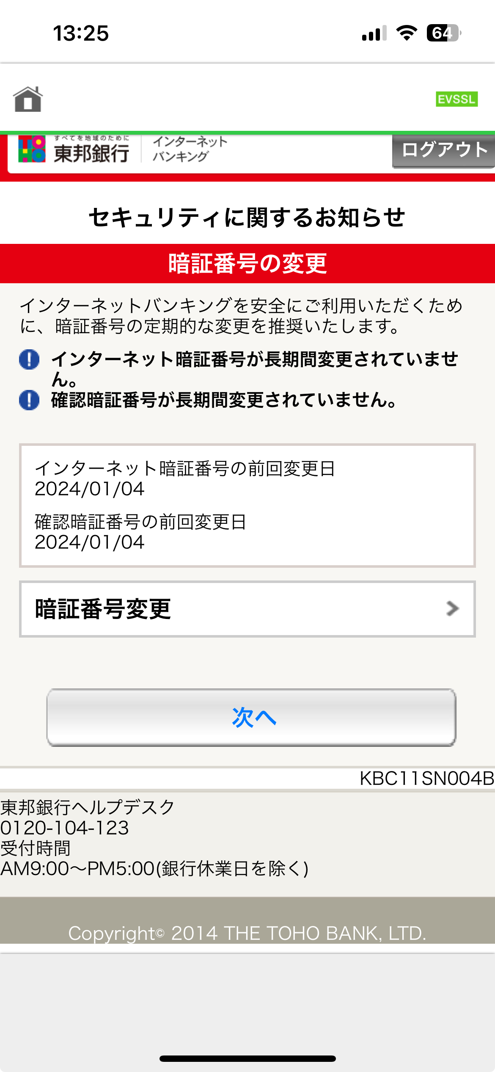
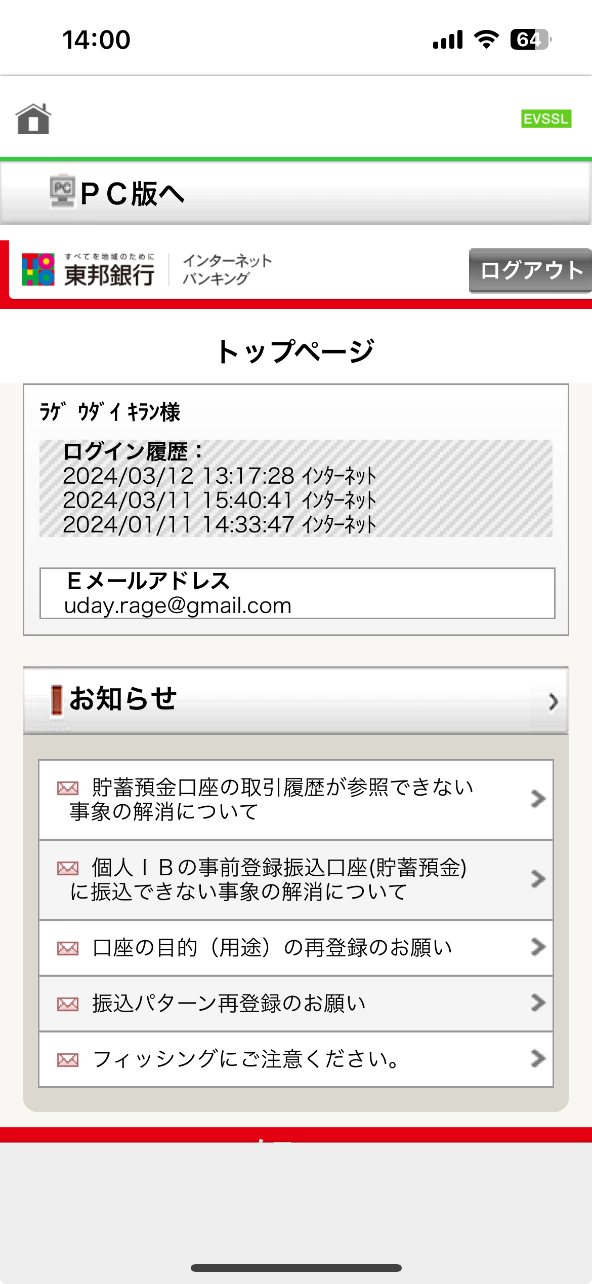
Scroll down
Press
Press
(Optional: You will see this screen, if you did not change password for sometime)

Slide 3
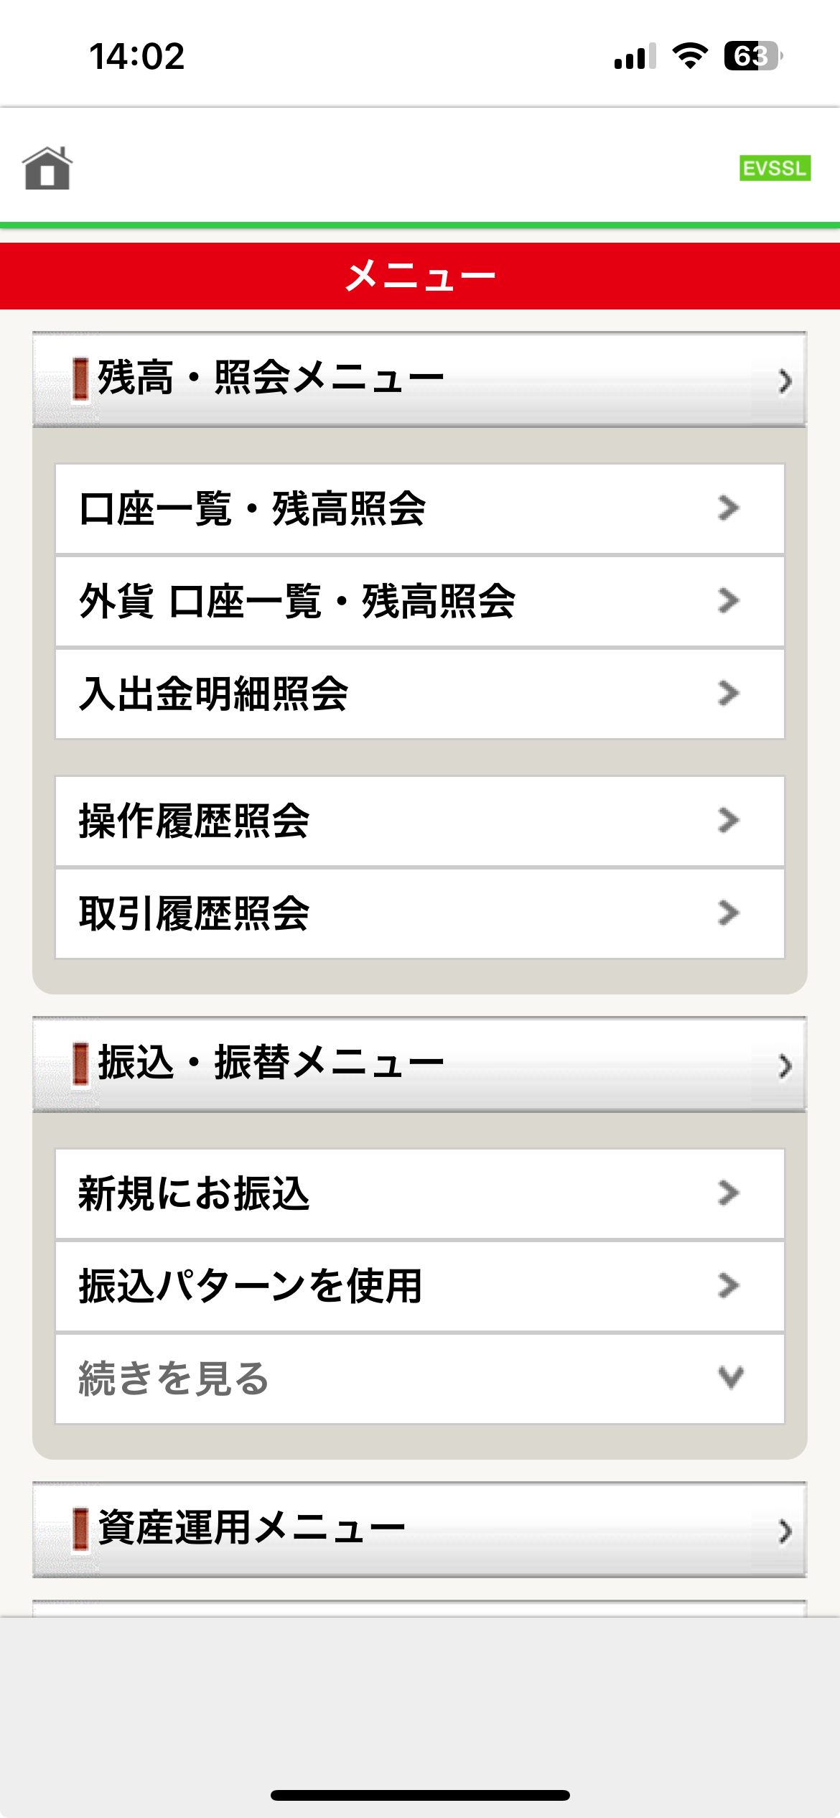
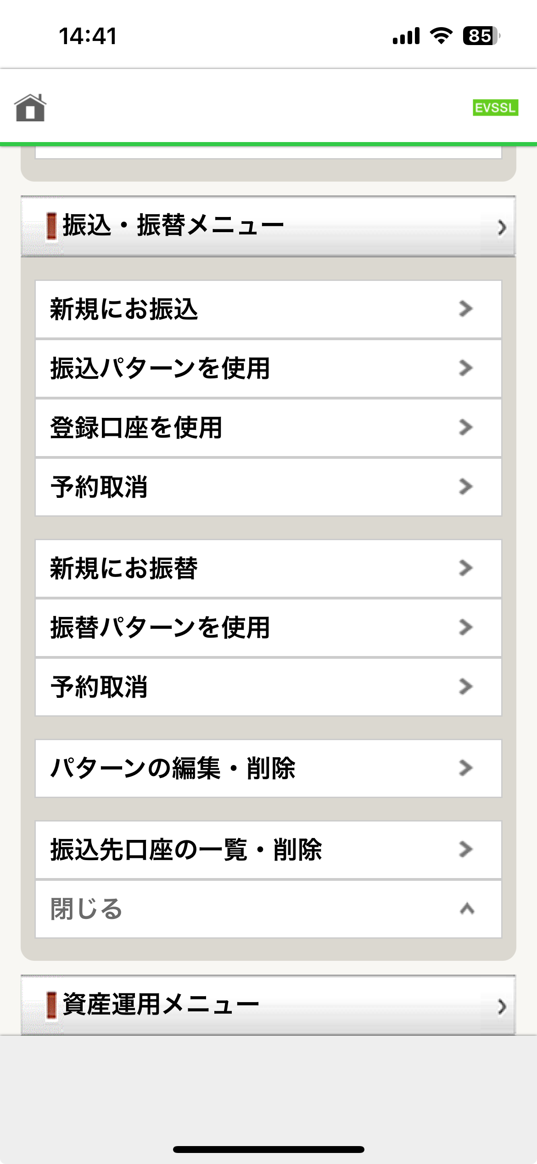
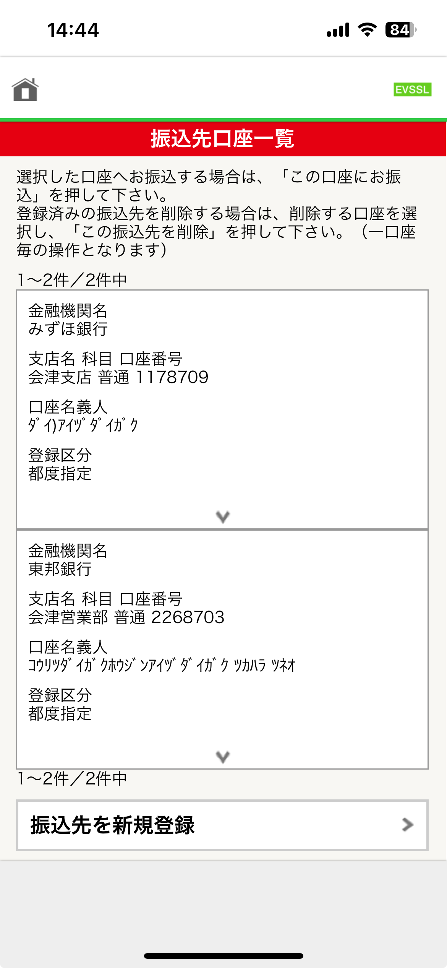
Click on the account to which you want to transfer money
Saved
accounts
are
shown
here
Press
Press

Slide 4
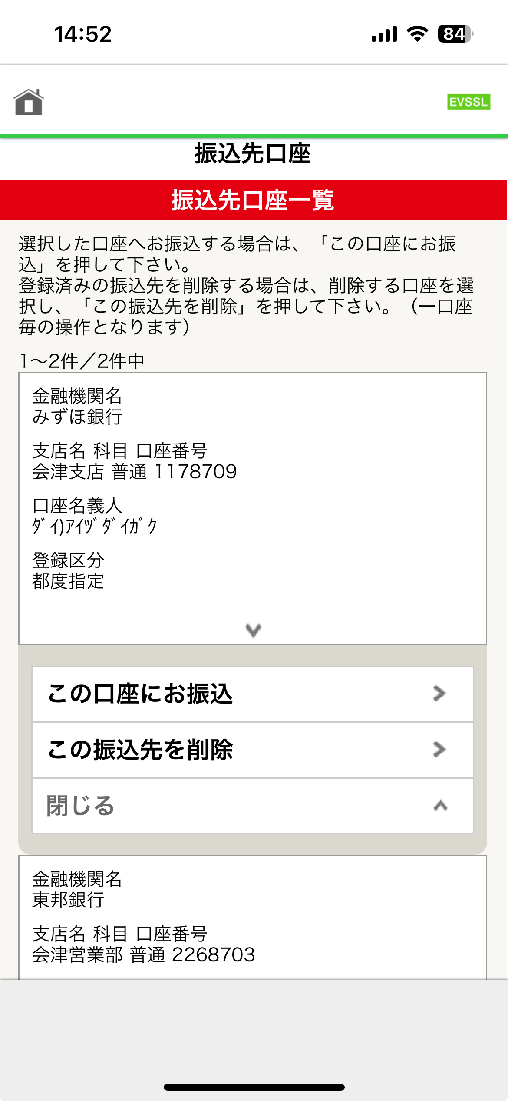
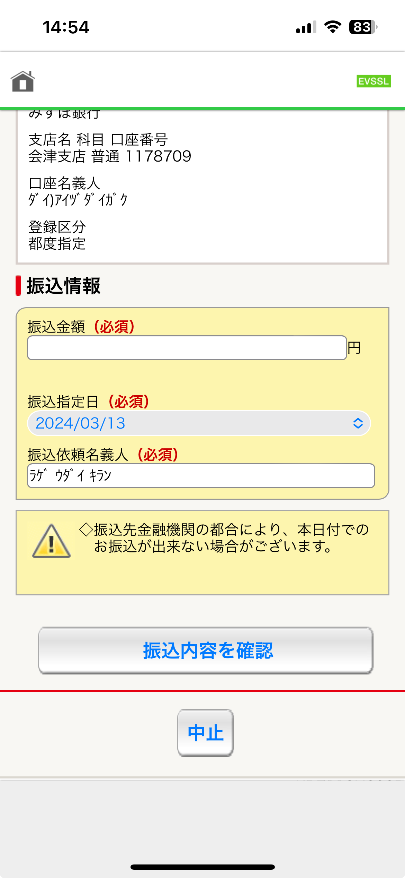
1. Type amount to send
Press
3. Press
2. Write the name of the sendor/person

Slide 5
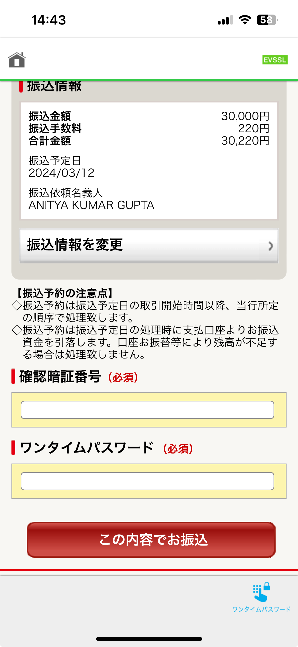
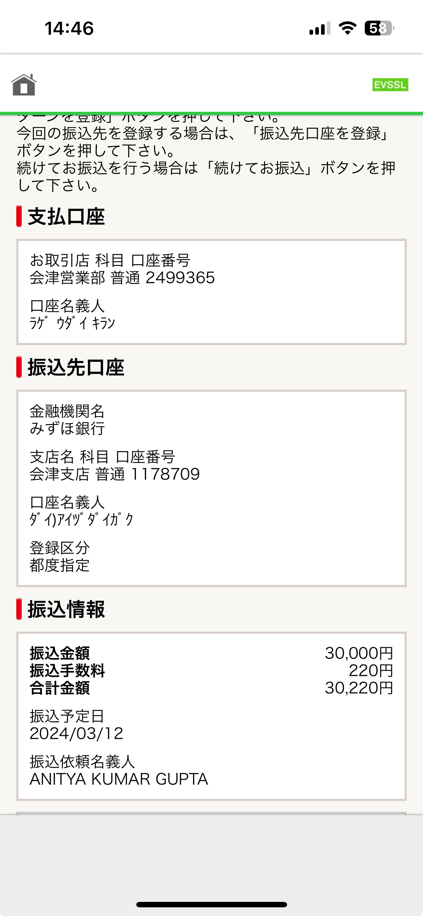
Final Screen.
Take screenshot
1. Enter the login password
(not pin number)
3. Random Numbers will appear here
4. Press the button to transfer money
2. Press this button

